Slide 1
Jumping At Shadows? Australia’s Underground (Black) Economy In The Post-Covid Era
Dr Michael Schaper
Senior Visiting Research Fellow, Institute of South East Asian Studies
Chair, Black Economy Advisory Board, Australia
Adjunct Professor, JCIPP, Curtin University
michael.schaper@gmail.com
JCIPP Curtin Corner, Curtin University, Perth
Friday 3rd July 2020
This perspective represents the author’s personal views and does not necessarily reflect those of any government agency.

Slide 2
Overview
The shadow economy: what is it?
Some international comparisons
The Australian experience
Recent reforms and emerging issues
What happens after Covid?

Slide 3
What Is The Shadow Economy?
Multiple different definitions exist
Unreported economic activities
“Economic activities (whether legal or illegal) which required to be reported but are not”(OECD 2017: 9)
Illicit money-making activities that essentially occur “off the books”
Out of sight and awareness by regulators, policymakers, administrators, tax collectors and statisticians
Includes both legitimate legal economic activities (should be reported but are not), as well as illegal behaviour
But does not cover voluntary work, charitable activities, DIY

Slide 4
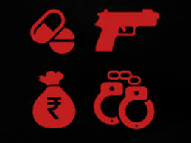
Typical Underground Economy Activities
Employer fraud (wage theft)
Unregistered businesses
Unreported business earnings (ie “cash jobs” or “mates rates”)
Unreported employment earnings (ie illegal immigrants)
Fake/inflated invoices & receipts
Phoenix companies
Smuggling (ie illicit tobacco)
Illegal drug manufacturing, distribution & sales
Trade in stolen goods
Tax ghosts (never register with ATO)
Identity fraud
Use of barter and cryptocurrencies
Prostitution & gambling (where illegal)
Source: OECD (2017) Shining Light On The Shadow Economy: Opportunities and Threats, Paris: OECD, pp.10-11.

Slide 5
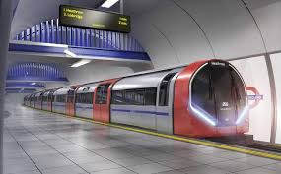
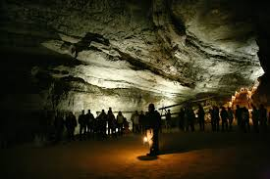
Also often known as …
Cash economy
Black economy
Parallel economy
Grey economy
Underground economy
Hidden economy
Non-observed economy

Slide 6
Why Does It Matter?
Lowers government revenue (tax)
…. = others pay more tax
… = reduced government services to the public
Unfair competition to small legitimate businesses
Put consumers at risk
Worker exploitation
Supports other serious crimes (people
trafficking, money laundering, organised crime)

Slide 7
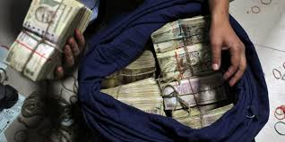
Ignorance
Don’t realise that income must be declared
Can be unclear in some parts of tax and labour laws
Tax & Regulatory Burden
Tax, wage bill is too great
Too many rules to follow
Excluded Groups
Illegal migrants, social security recipients, etc
Unable to work in conventional jobs
Why Do Individuals Participate In The BE?
Opportunity
Is it easy to cheat the system?
High Profits
Make more $
More “take home” income than under licit systems
“Everyone Else Does It”
Believe others are getting away with it
Corruption
Community acceptance/support
Low Risk Of Being Caught
Weak compliance/enforcement systems
Low chance of being audited
No or low penalties
Notes:
5

Slide 8
The Grey Economy Can Also Have Positive Effects
Much black money becomes white:
About 2/3 of BE income is immediately spent in the official economy
A positive stimulus on the formal/legitimate economy
Jobs and wealth are created:
In developing countries, often only way to earn a livelihood
But no wealth is shared with the public (government)
Many underground operators move to the legitimate arena:
When opportunity arises and legal incomes increase (ie Canada)
Source: Schneider, Friedrich and Enste, Dominik (2002) Hiding In The Shadows: The Growth of the Underground Economy, IMF Economic Issues No. 30, Washington DC: IMF, p.2.

Slide 9
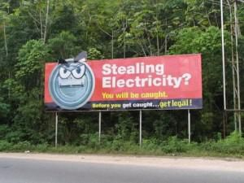
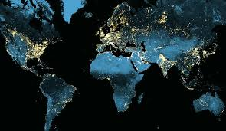
How Can We Measure It?
Difficult; no universal standard method or definition used
Direct approaches:
Interview members of the public (informal work, informal buying/selling)
Interview company managers (business turnover, wages reporting)
Undertake tax audits
Measuring discrepancies:
Between GDP income & expenditure
Between official & actual labour force size
Between estimated & actual tax collection
Demand for currency (cash) & GDP
Usage of physical inputs (ie electricity)
Night lights (energy)
Waste water (drugs)
Sources: Schneider, Friedrich and Enste, Dominik (2002) Hiding In The Shadows: The Growth of the Underground Economy, IMF Economic Issues No. 30, Washington DC: IMF, p.2; Medina, Leandro & Schneider, Friedrich (2018) Shadow Economies Around the World: What Did We Learn Over the Last 20 Years?, IMF Working Paper WP/18/17, Washington DC: International Monetary Fund.

Slide 10
Different Economies Have Very Different Levels of BE Activity
Regional Average, 2010-15 | GDP %
OECD | 15.28%
East Asia | 21.24%
Middle East/North Africa | 23.42%
South Asia | 28.11%
Latin America/Caribbean | 33.39%
Sub-Sahara Africa | 36.16%
Global Average | 31.9%
Source: Medina, Leandro & Schneider, Friedrich (2018) Shadow Economies Around the World: What Did We Learn Over the Last 20 Years?, IMF Working Paper WP/18/17, Washington DC: International Monetary Fund, Figure 3.4, p.58. Derived using MIMIC approach.

Slide 11
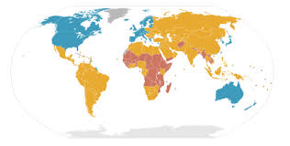
International Comparisons
BE tends to be highest in developing countries, lowest in OECD nations
Is lower in countries with
low tax rates
fewer laws & regulations
clear efficient enforcement of the law
well-established rule of law
few self-employed workers
Source: Schneider, Friedrich and Enste, Dominik (2002) Hiding In The Shadows: The Growth of the Underground Economy, IMF Economic Issues No. 30, Washington DC: IMF, p.2.

Slide 12
Best (and worst) Global Performers, 1991-2015
Country Average, 1991-2015 | GDP %
Switzerland | 7.2%
USA | 8.3%
Austria | 8.9%
Zimbabwe | 60.6%
Bolivia | 62.3%
Georgia | 64.9%
Source: Medina, Leandro & Schneider, Friedrich (2018) Shadow Economies Around the World: What Did We Learn Over the Last 20 Years?, IMF Working Paper WP/18/17, Washington DC: International Monetary Fund, Table 18, pp.50-54. Derived using MIMIC approach.

Slide 13
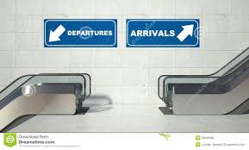
Global Trends & Evidence
More people move into the black economy when:
Taxes increase too much
Employment/labour laws and pay rates become too high
Social security payments are too low or rules too difficult to comply
Limits are placed on how many hours people can officially work
More people move out of the black economy when:
Wages in the formal economy increase
Corruption in official economy is reduced
Source: Schneider, Friedrich and Enste, Dominik (2002) Hiding In The Shadows: The Growth of the
Underground Economy, IMF Economic Issues No. 30, Washington DC: IMF, p.2.

Slide 14
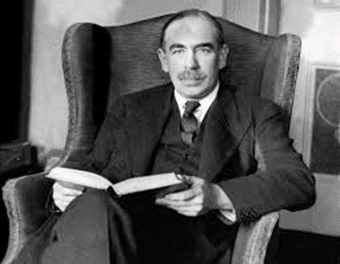
Cultural Views & Differences Also Matter
“Only fools pay.”
Popular Italian saying.
“The avoidance of taxes is the only intellectual pursuit that carries any reward.”
John Maynard Keynes (1883-1946)

Slide 15
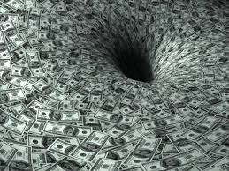
How Big Is Australia’s Black Economy?
Several estimations:
IMF: 12% of GDP in 2015
ABS: 1.9% of GDP in 2012
Black Economy Report: 3% of GDP in 2017 (= $50 billion )
Sources:
Medina, Leandro & Schneider, Friedrich (2018) Shadow Economies Around the World: What Did We Learn Over the Last 20 Years?, IMF Working Paper WP/18/17, Washington DC: International Monetary Fund, Figure 3.4, p.58. Derived using MIMIC approach.
Treasury (2017) Black Economy Taskforce Final Report, October, Canberra: The Treasury, p.1.

Slide 16
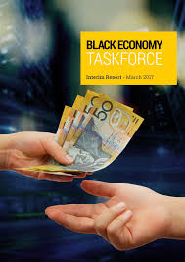
Recent Australian Initiatives
Ban on sales-suppression software/electronic tills
ABF: Illicit Tobacco Taskforce seized 77+ tonnes (worth $89m)
Treasury: Black Economy Advisory Board meeting 2/3 times annually
11 agencies: Black Economy Standing Taskforce operating
ATO: bidders for major federal tenders must provide statement of their tax records
ATO: Taxable Payments Reporting System (expanded
from just building & construction to also now include others)
ATO: 13,000+ business field visits
ATO: Over 100,000 tip-offs to Tax Integrity Centre (hotline)
Additional $1.5 billion revenue raised

Slide 17
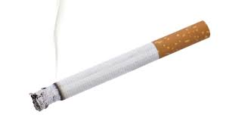
What Next in Australia?
$10,000 cash limit
Governs business-to-business and business-to-consumer acts, not private ones
Still to be legislated: Currency (Restrictions on Use of Cash) Bill 2019 currently in Parliament (awaiting Senate consideration)
Illicit tobacco: ongoing area
Wage theft: continued area of concern
ABN reforms: reduce unused ABNs, require regular re-registration
Sharing economy: from July 2022, will be required to advise ATO what income payments have been made to whom

Slide 18
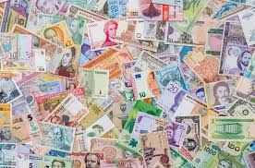
Did You Know?
There are over 500 billion banknotes in circulation globally
Source: OECD (2017) Shining Light On The Shadow Economy: Opportunities and Threats, Paris: OECD, pp.16.

Slide 19
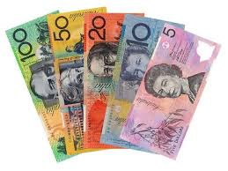
What Do We Use Our Cash For?
The Reserve Bank of Australia is the sole issuer and redeemer of Australian banknotes. It estimates that of all banknotes:
15–35% are used for legitimate transactions;
50-75% are hoarded/stored;
4–8% are used in the shadow economy;
5–10% are lost.
Source: Finlay, R.; Staib, A. & Wakefield, M. (2018) Where's the Money? An Investigation Into The
Whereabouts and Uses of Australian Banknotes, RDP 2018-12, Sydney: Reserve Bank of Australia.

Slide 20
Not All Outcomes Are Predictable…

Slide 21
What Happens After Covid?
More electronic banking?
Reduced smuggling?
More illegal tobacco?
Reduced drug/cash trafficking?
More (or fewer) shadow businesses?
Easier compliance checking?
A greater (or lesser) compliance culture?

Slide 22
What Happens After Covid?
More electronic banking?
“Many of us have chosen to be cashless for the moment. I must say for my own business it has made transactions so much easier to manage … I know the concept of being a cashless economy is often in discussion. I for one would support no wages in cash.”
Better intelligence?
“With the community preferring to have no contact transactions, the use of credit and debit cards is allowing us much better compliance and tracking … ”
More illegal tobacco?
“During the lockdown here, beers and cigarettes were prohibited from being distributed and production ordered to stop … As a consequence, the illicit/smuggled liquor, alcohol and cigarettes became rampant again to fill the void.”
More small-scale, home-based businesses in future?
More businesses moving out of the regulated economy?

Slide 23
Useful Reading
Bajada, Christopher & Schneider, Friedrich (2005) “The Shadow Economies of the Asia-Pacific,” Pacific Economic Review, Vol.10 No.3, pp.379-401.
Finlay, R.; Staib, A. & Wakefield, M. (2018) Where's the Money? An Investigation Into The Whereabouts and Uses of Australian Banknotes, RDP 2018-12, Sydney: Reserve Bank of Australia.
Medina, L. & Schneider, F. (2018) Shadow Economies Around the World: What Did We Learn Over the Last 20 Years?, IMF Working Paper WP/18/17, Washington DC: International Monetary Fund.
OECD (2002) Measuring The Non-Observed Economy: A Handbook, Paris: OECD.
OECD (2017) Shining Light On The Shadow Economy: Opportunities and Threats, Paris: OECD.
Schaper, M.T. (2020) Schaper, M.T. (2020) “The Black Economy in Southeast Asia: Current Issues and Future Challenges” ISEAS Perspectives, No.55, 29th May, Singapore: Institute of South East Asian Studies-Yusof Ishak Institute.
Schneider, F. & Enste, D. (2002) Hiding In The Shadows: The Growth of the Underground Economy, IMF Economic Issues No. 30, Washington DC: International Monetary Fund.
The Treasury (2017) Black Economy Taskforce Final Report, Canberra: The Treasury, Commonwealth of Australia.

